Slide 1
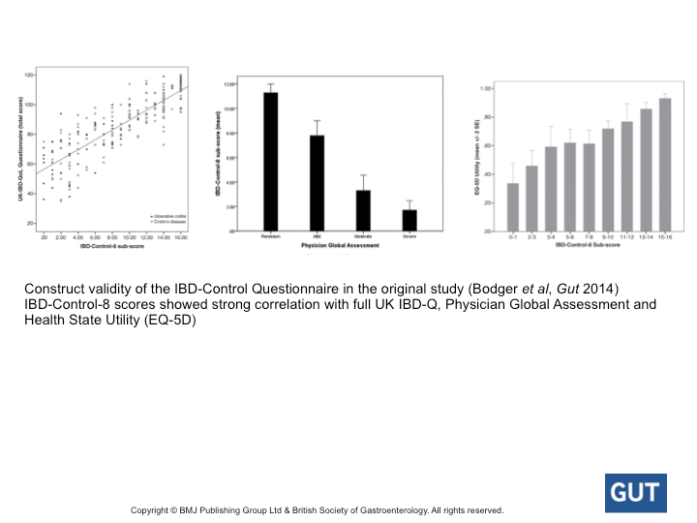
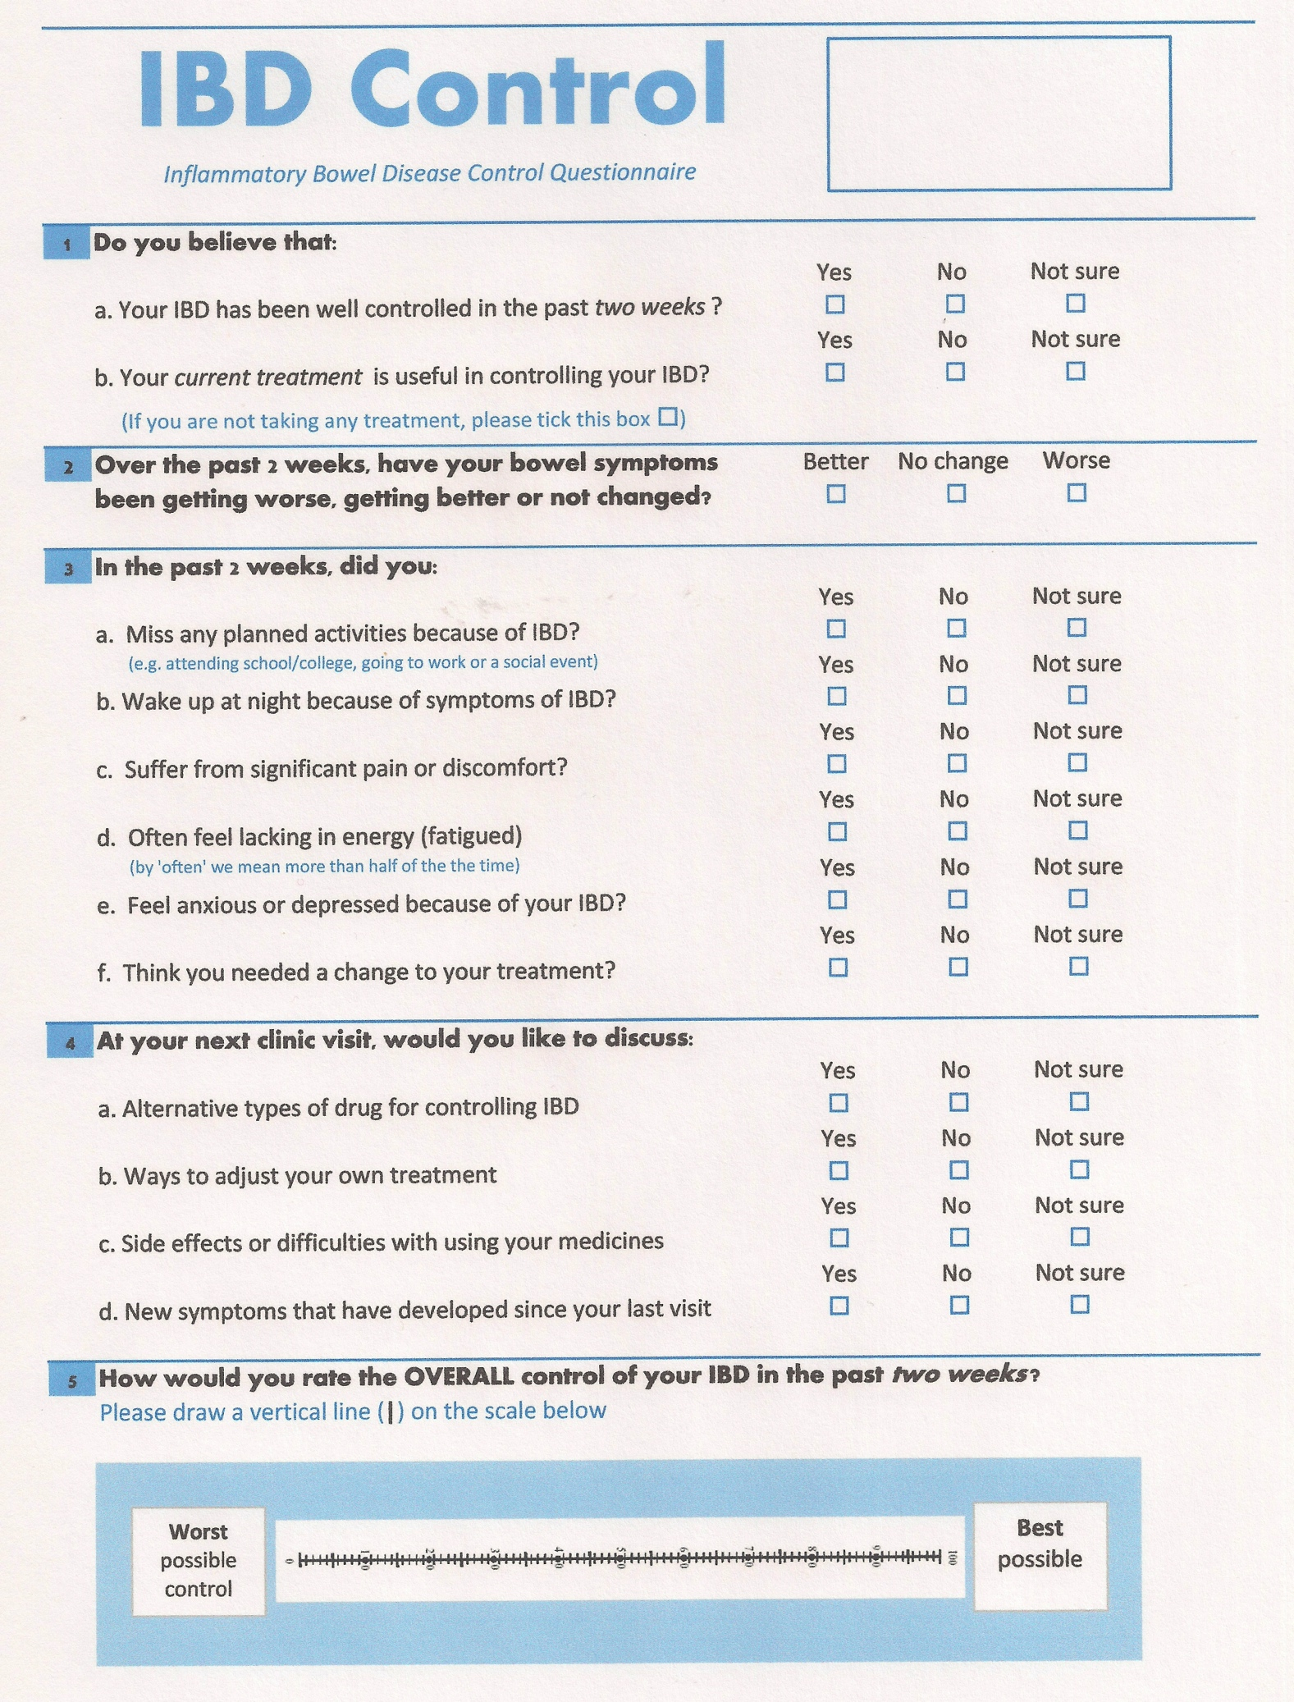

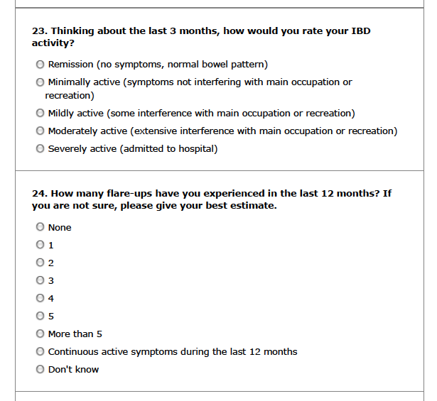
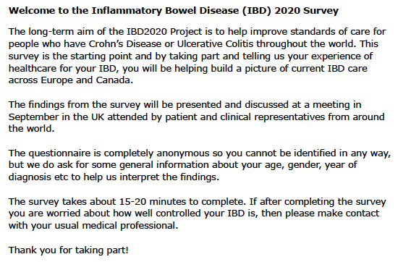
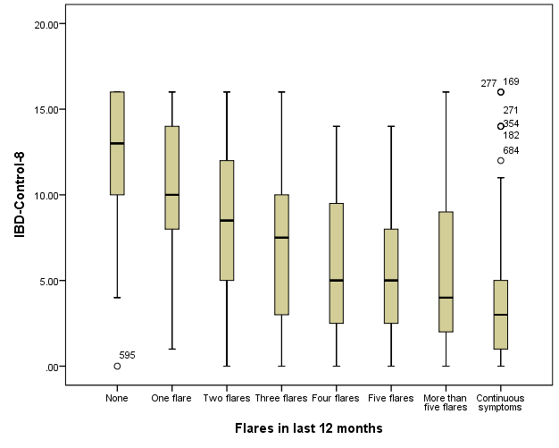
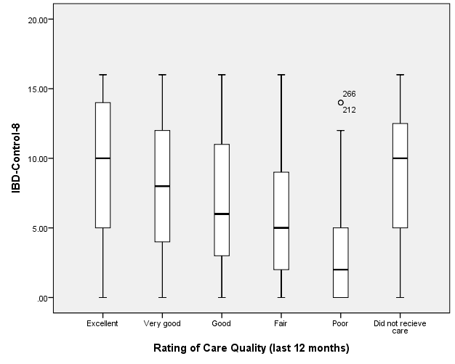
Independent Validation of the IBD-Control Questionnaire:
Results from a large-scale electronic patient experience survey (IBD2020)
Keith Bodger¹, Tamsin Gledhill¹, Richard Driscoll², Helen Terry³, Peter Irving⁴, Simon Travis⁵
¹Univ. of Liverpool, Liverpool; ²The Riva Partnership Ltd, Barnet; ³Crohn’s & Colitis UK, St Albans; ⁴Guy’s & St. Thomas’ Hospitals, London; ⁵Nuffield Department of Medicine, University of Oxford
Introduction
The IBD-Control Questionnaire is a self-completed patient reported outcome measure developed to rapidly capture disease control from the patient perspective.(1) Eight of the question items generate a summary score (IBDControl-8) ranging from 0 (worst control) to 16 (best control).
Aims
We aimed to evaluate the feasibility of capturing the IBD-Control-8 items electronically (rather than on paper) and to validate their measurement properties independently within the setting of a large-scale UK patient experience survey.
Methods
The IBD2020 survey was an electronic (online) questionnaire of patient experiences of healthcare across Europe, promoted in the UK by the national charity, Crohn’s and Colitis UK (www.IBD2020.org). The survey included items about sociodemographics, disease type, treatments, self-reported disease activity (last 3 months), relapse status (last 12 months), disease impact and a wide range of questions about care experiences. The IBD-Control-8 questions were incorporated into the UK survey, allowing an opportunity to validate its association with other patient ratings of health status and care.
IBD-Control-8 items
Results
818 UK patients completed the survey (Female n=611; Under 30 years, n=259; 30-44 yrs n=352; 45-59 yrs n=42, 60 yrs plus n=45; CD n=483; Previous surgery n=275; Current stoma n=69). Self-reported disease activity in last 3 months: Remission 10.8%, Minimal 21.1%, Mildly 28.0%, Moderately 22.1%, Severely 8.7%, Missing 9.3%.
701/818 (85.7%) completed all IBD-Control-8 questions, (mean score [sd]: 7.3 [4.9]; range: 0-16). Internal consistency was strong (Cronbach’s alpha: 0.82). Construct validity of IBD-Control-8 was confirmed by: (a) moderately strong negative correlation (Spearman’s rho values) with ‘Disease Activity In Last 3 months’ (Overall -0.68; CD -0.67; UC -0.66; Post-surgery -0.65) and ‘Number of Relapses in Last 12 months’ (Overall -0.61; CD -0.59; UC -0.60; Post-surgery -0.58; Fig. 1) and (b) Significantly higher mean [sd] scores for remission versus any level of disease activity (13.1 [3.1] versus 6.4 [4.5]; p<0.001). IBD-Control-8 scores were lower with progressively lower global rating of care received (Fig. 2). Utility of IBD-Control-8 as a screening test to identify ‘quiescent’ patients (score of 13+)¹ was confirmed (specificity: 88.2% versus self-reported ‘remission’ status; 95% versus remission or minimal activity).
Conclusions
The IBD-Control-8 items from the IBD-Control Questionnaire are well suited to large-scale electronic surveys, with excellent completion rates within a lengthy patient experience survey. This study provides independent confirmation of its previously reported psychometric properties in a large cohort of UK patients. The instrument is freely available for use in routine settings. Global care ratings are associated with health status at the time of survey and results require careful interpretation.
Progress and future developments
The data items for the IBD-Control-8 have been integrated successfully into the UK IBD Registry, thereby allowing participating teams to record PROM data in routine practice via the registry patient management system or the new registry portal.
Direct capture of IBD-Control from patients is to be tested in the CCUK-sponsored patient portal, ‘My IBD Portal’ developed by the team at Salford Royal NHS Foundation Trust (www.myibdportal.com).
A Spanish translation and independent validation study is under way.
IBD-Control is being used by teams in the USA, Europe and Australia to support routine care or research.
Reference
1. Bodger K et al. Development and validation of a rapid, generic measure of disease control from the patient's perspective: the IBD-Control questionnaire. Gut 2014;63:1092-1102.
Acknowledgement
We thank CCUK for supporting the IBD2020 and providing permission to undertake this analysis. The original development and validation of IBD-Control (KB) was supported by a project grant from AbbVie.
Fig. 1 Construct validity: IBD-Control-8 score versus number of flares in last 12 months (p<0.01)
Fig. 2 Rating of care: IBD-Control-8 score versus overall rating of care quality (p<0.01)

